Slide 1

Graph PowerShell
where sysadmins meet developers
Stephan van Rooij

Slide 2
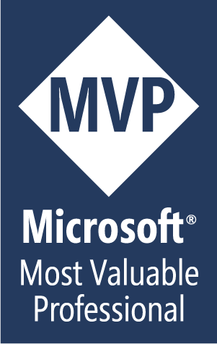
Hello!
I am Stephan van Rooij
Speaker - Software architect – Microsoft MVP
You can find me at
@svrooij or https://svrooij.io

Slide 3
What is the Microsoft Graph (api)
And why should I care?

Slide 4
Microsoft Graph API is a single endpoint where you can control (almost) all Microsoft cloud resources

Slide 5
Microsoft Graph API
Add/Remove/Update
Users and Groups
Manage Intune
Manage all Microsoft 365 resources

Slide 6

Microsoft Graph PowerShell SDK

Slide 7
Microsoft Graph PowerShell SDK (pros)
All Microsoft 365 resources
Developer goodies for sysadmins
Modern authentication by default (MFA)
Fast access to new features
Platform independent

Slide 8
Microsoft Graph PowerShell SDK (cons)
Modules are generated
Good for developers, not for admins
Harder to run unattended
Does not follow PowerShell syntax/logic

Slide 9
Execute your first command
Install base module
Find command
Login with needed scopes
1
3
5
2
4
6
Find graph api resource
Install additional modules
Execute your command

Slide 10
43 modules?
PowerShell gallery has 43 modules
Microsoft.Graph.*

Slide 11
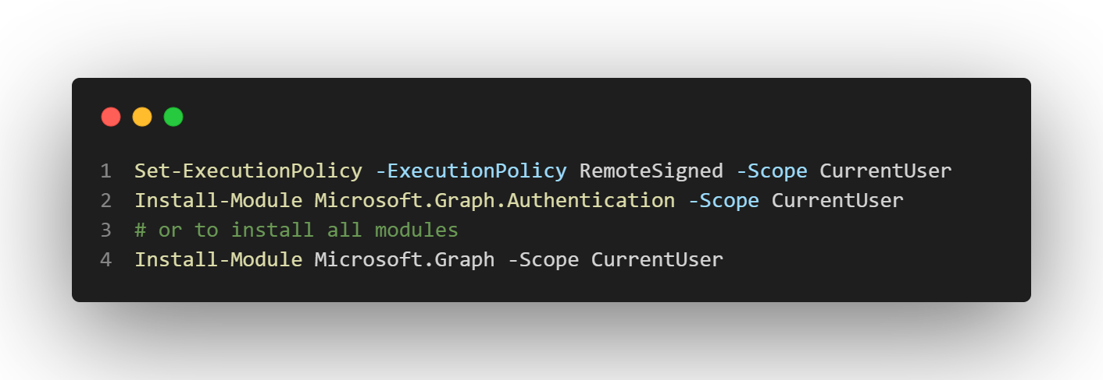
Install the base module
Install-Module Microsoft.Graph.Authentication –Scope CurrentUser
Notes:
Set-ExecutionPolicy -ExecutionPolicy RemoteSigned -Scope CurrentUser
Install-Module Microsoft.Graph.Authentication -Scope CurrentUser

Slide 12
List groups
https://learn.microsoft.com/en-us/graph/api/group-list
Find the command
Find-MgGraphCommand -Uri '/groups'
Authenticate
(required scope ‘Group.Read.All’)
Execute the command
Get-MgGroup
Notes:
Find-MgGraphCommand -Uri '/groups'

Slide 13
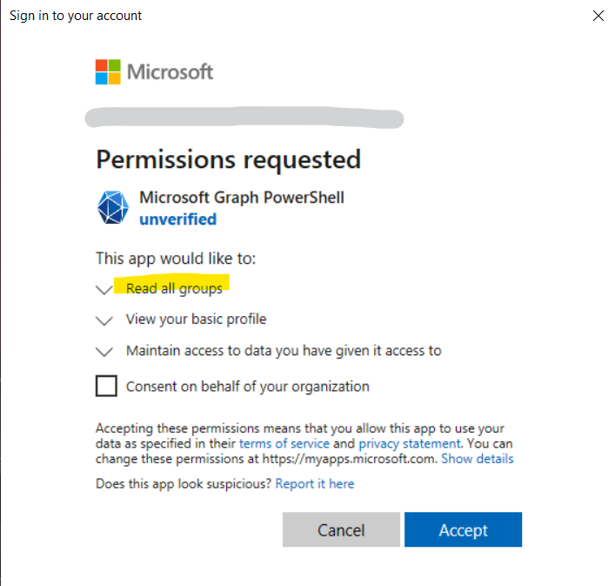
Login as user (scope ‘Group.Read.All’)
Connect-MgGraph –Scopes "Group.Read.All"
Notes:
Connect-MgGraph -Scopes "Group.Read.All"

Slide 14
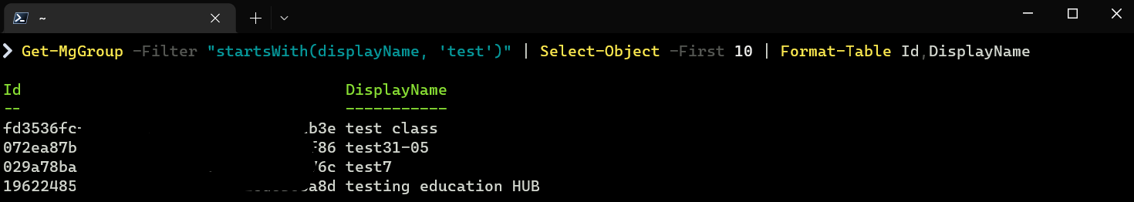
List groups starting with ‘test’
Get-MgGroup -Filter "startsWith(displayName, 'test')"
Notes:
Get-MgGroup -Filter "startsWith(displayName, 'test')"

Slide 15
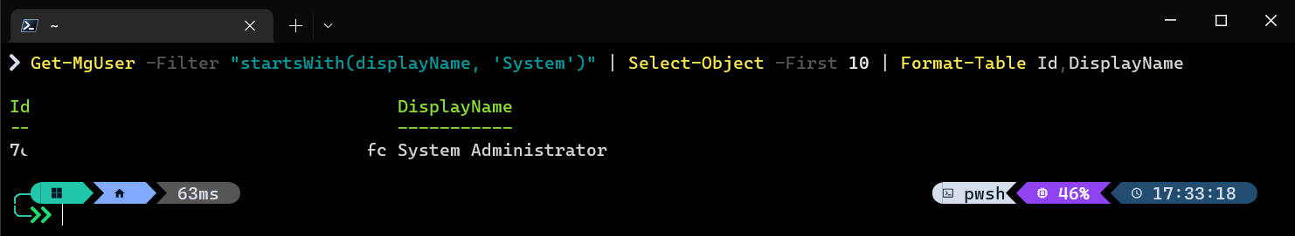
List users starting with ‘system’
Microsoft.Graph.Users scope “User.Read.All”
Get-MgUser -Filter "startsWith(displayName, ‘System')"

Slide 16
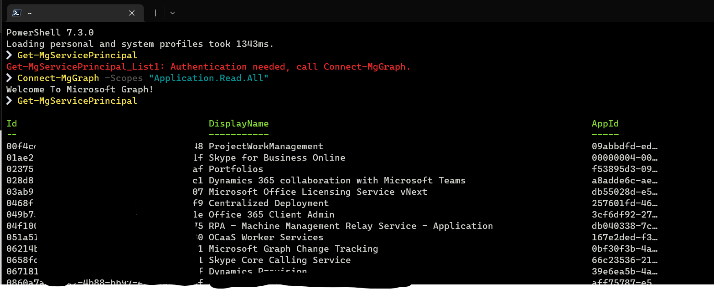
Get all service principals
Get-MgServicePrincipal

Slide 17
Microsoft Graph PowerShell SDK Autehtication
User (or delegated) authentication
Access the Graph API as a user
User context, reading allowed by default
Editing needs admin role in Azure AD
Request scopes in the connect command
App-only authentication
Create application to access Graph API
Useful for unattended scripts
Configure scopes in Azure AD
and Grant admin consent
You need to keep the secret, SECRET!
https://learn.microsoft.com/en-us/powershell/microsoftgraph/authentication-commands

Slide 18
Run script unattended
Notes:
GitHub - svrooij/powershell-snippits: Some usefull PowerShell snippets collected

Slide 19
Run Microsoft Graph PowerShell script unattended
Create self-signed certificate
Specify permissions
Upload public part of certificate
1
3
5
2
4
6
Create app registration
Grant Admin consent
Run your command without interactive login

Slide 20
Run script unattended - Certificate
Create self-signed certificate
(disable export key!)
New-SelfSignedCertificate -NotAfter $(Get-Date).AddYears(1) -FriendlyName "Unattended powershell m365" -CertStoreLocation cert:\CurrentUser\My -Subject "CN=powershell.invalid" -KeyAlgorithm RSA -KeyLength 2048 -KeyExportPolicy NonExportable
Notes:
New-SelfSignedCertificate -NotAfter $(Get-Date).AddYears(1) -FriendlyName "Unattended powershell m365" -CertStoreLocation cert:\CurrentUser\My -Subject "CN=powershell.invalid" -KeyAlgorithm RSA -KeyLength 2048 -KeyExportPolicy NonExportable

Slide 21
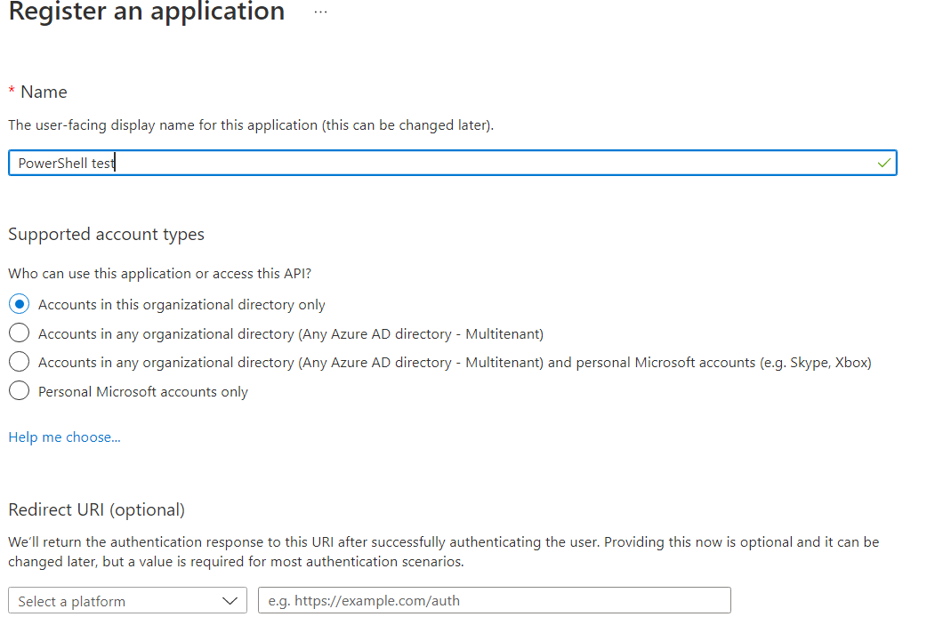
Run script unattended – App registraion
Create app registration at (https://adappreg.cmd.ms)

Slide 22
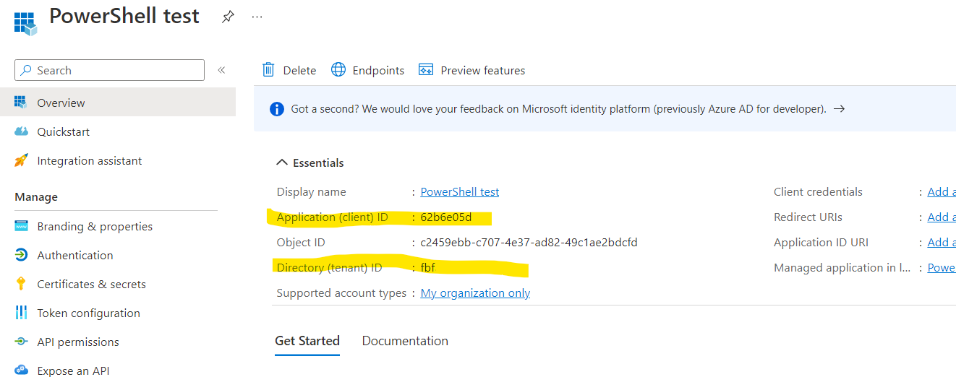
Run script unattended – App registraion
Copy details

Slide 23
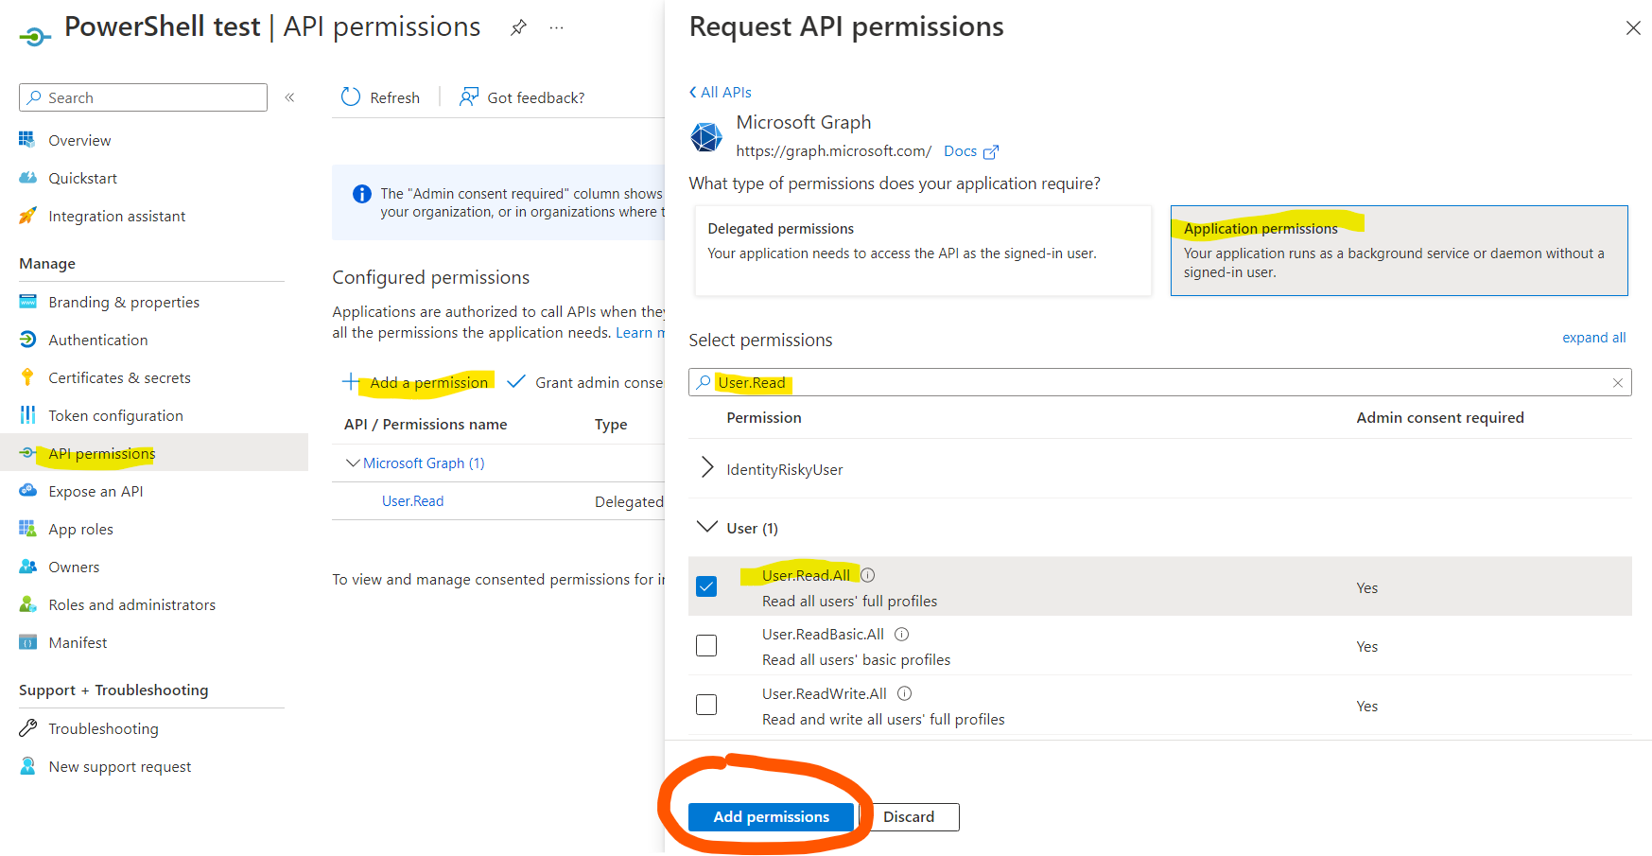
Run script unattended – Permissions
Add needed permissions under API Permissions

Slide 24
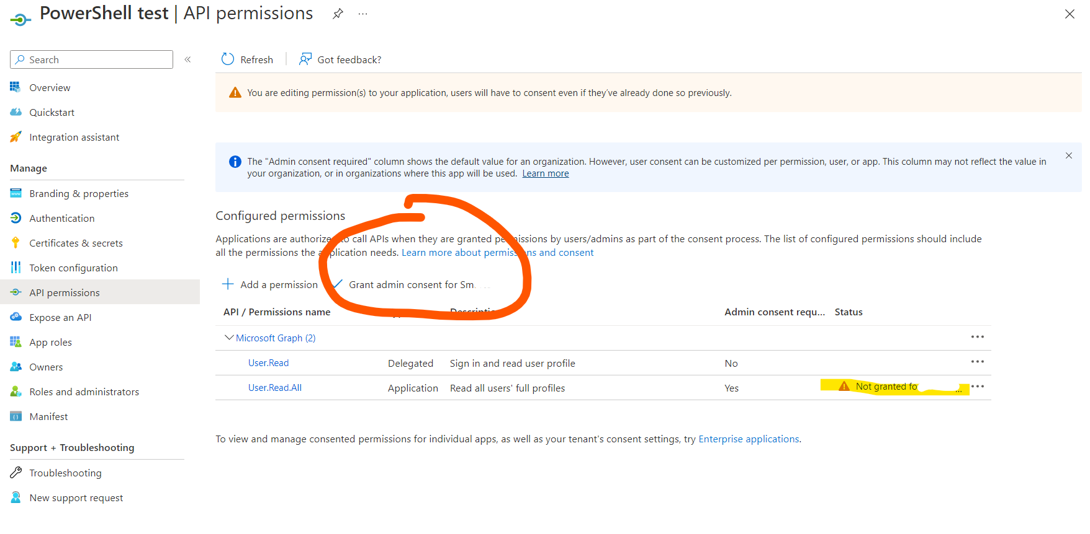
Run script unattended – Admin consent
Press Grant admin consent

Slide 25
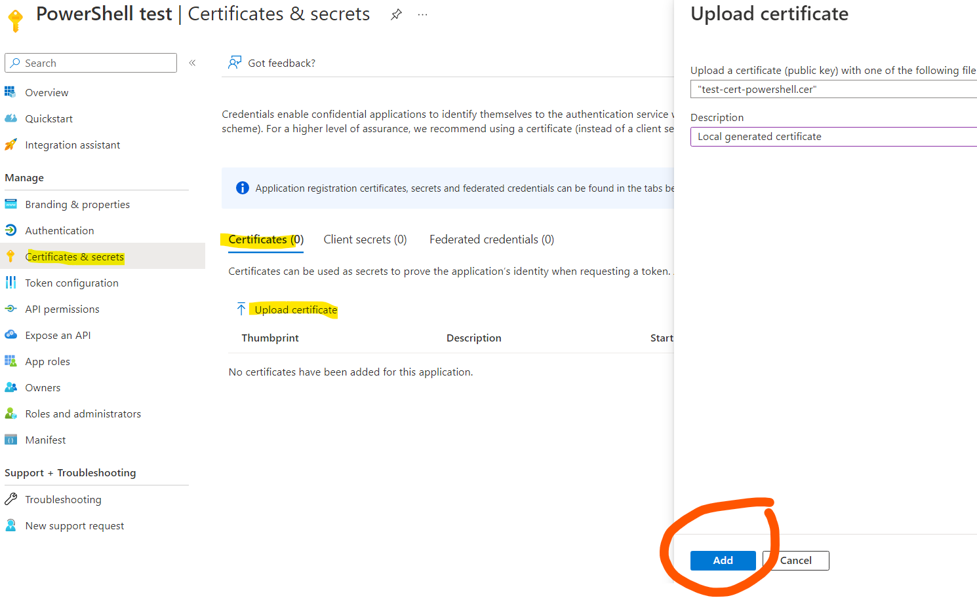
Run script unattended – Upload public key
Upload the public key of the self signed cert
(export as base64)

Slide 26
Run script unattended – Replace Connect-MgGraph
Connect-MgGraph
-ClientId "7fc0a26b-4a0c-4570-aa4b-5a3e4978feec"
-Tenant "3837822b-f900-4785-81ce-1c7f17605bef"
-CertificateThumbprint "e0b85f7c67c27d36d54db3daddaad62b29c366f1"
Notes:
Connect-MgGraph -ClientId "7fc0a26b-4a0c-4570-aa4b-5a3e4978feec“ -Tenant "3837822b-f900-4785-81ce-1c7f17605bef“ -CertificateThumbprint "e0b85f7c67c27d36d54db3daddaad62b29c366f1"

Slide 27
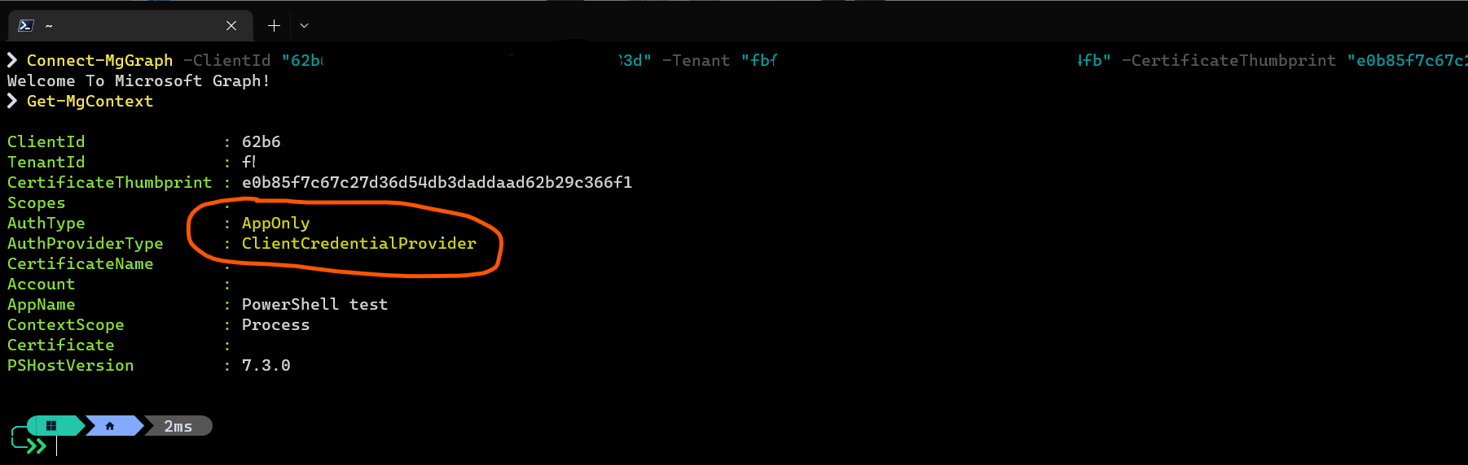
Run script unattended – Check context
Get-MgContext

Slide 28
Every user has access!
By default every user in the tenant has access to these modules!

Slide 29
Create scam list with convincing details
Microsoft.Graph.Users scope “User.Read.All”
$filename = $(New-TemporaryFile).FullName
Get-MgUser | Select-Object -Property Id,Birthday,CompanyName,Department,JobTitle,Mail,GivenName,Surname,DisplayName,UserPrincipalName | Export-Csv -Path $filename
Write-Host "Users exported to $filename"

Slide 30
See users who are using these modules
Open Azure portal -> Enterprise applications (https://adapp.cmd.ms)
Switch to All applications
Search for Microsoft Graph
Open Microsoft Graph PowerShell
Click Sign-in logs
(or Audit logs for changes)

Slide 31
Block users from using these modules
Open Azure portal -> Enterprise applications (https://adapp.cmd.ms)
Switch to All applications
Search for Microsoft Graph
Open Microsoft Graph PowerShell
Switch Assignment required to Yes
Notes:
Set-ExecutionPolicy -ExecutionPolicy RemoteSigned -Scope CurrentUser
Install-Module Microsoft.Graph.Authentication -Scope CurrentUser

Slide 32
Configure conditional access for these modules
Conditional access policies targeting Microsoft Graph PowerShell specifically?
Under Cloud Apps, you can set the App ID:
14d82eec-204b-4c2f-b7e8-296a70dab67e

Slide 33

More useful scripts?
https://svrooij.io

Slide 34
Microsoft Graph PowerShell
Graph API
Control all M365 resources from a single endpoint
PowerShell SDK
Control all M365 resources available in the Graph API
Execute first command
Find and execute your first commands
Run Unattended
Create an application and run without user interaction
Security risks
Each user has access by default, discover and prevent.
cmd.ms
Awesome url shortcuts to all M365 (admin) portals.

Slide 35
Thanks!
Any questions?
You can find me at:
@svrooij
📧 me@svrooij.io
💻svrooij.io
https://svrooij.io/talks.html for slides

Slide 36
Credits
Special thanks to all the people who made and released these awesome resources for free:
Presentation template by SlidesCarnival
Photographs by Unsplash

Slide 37

Free templates for all your presentation needs
For PowerPoint and Google Slides
100% free for personal or commercial use
Ready to use, professional and customizable
Blow your audience away with attractive visuals

Slide 38
SlidesCarnival icons are editable shapes.
This means that you can:
Resize them without losing quality.
Change fill color and opacity.
Isn’t that nice? :)

